Slide 1
Presentation Topic : Cardiac Disease Detection
Khondkar Md. Mufrat Tasif
UG02-47-18-044

Slide 2
Outline
Introduction
Type of Cardiac Disease
Describes Some Types
Symptoms of this Disease
Risk Factor of Cardiac Disease
Investigation By Testing ( Detections)
Treatment
Prevention

Slide 3
Introduction
All heart disease are cardiac disease but all cardiac disease are not heart disease. So it’s means a range of conditions that affect of our heart.
It is a psychological conditions that’s affect heart or blood vessel. Heart / Cardiac disease is leading cause of death for man or women .

Slide 4
Types of Cardiac Disease
1. Coronary Artery Disease (CAD)
2. Heart Arrhythmias.
3. Heart Failure.
4. Heart Valve Disease.
5. Pericardial Disease.
6. Cardiomyopathy (Heart Muscle Disease)
7. Congenital Heart Disease.
8. Heart Infection

Slide 5
Describes Some Types
1. Coronary Artery Disease (CAD) - This disease create blockage or narrow in our arteries and can be decrease our blood flow in heart .
2. Heart Arrhythmias - When we have an arrhythmia that time out heart has an irregular beating .
3. Heart Failure - Our heart doesn’t pump blood as well as our body needs .
4. Heart Valve Disease - Our heart have four valve to always open and close to direct blood flow, but when an abnormality could make it hard, that time our blood flow could be block or leak and heart not be open or close.

Slide 6
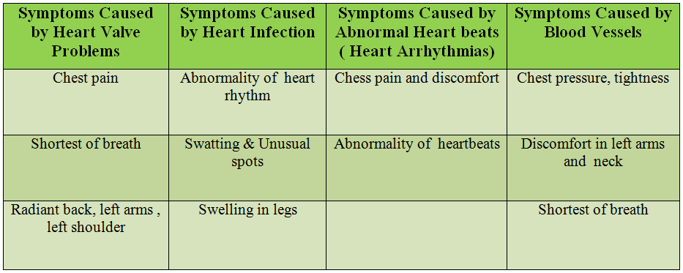
Symptoms of this Disease

Slide 7
Risk Factor of Cardiac Disease
1. Overweight
2. Diabetes
3. Physical Inactivity
4. High Blood Pressure (Hypertension)
5. High Blood Cholesterol (Hyper cholestromia)
6. Smoking
7. Alcohol
8. Past history of ischemic heart disease.

Slide 8
Investigation by Testing ( detection )
1. ECG ( Check heart Rhythm)
2. CKMV ( Blood test)
3. Cardiac Troponin I ( Detect level Proteins blood)
4. Echocardiography ( Checks heart chamber and valve)
5. Coronary Angiography (X-ray imagine blood vessel)
6. Heart Chest X-ray (Checks problems in heart lungs)

Slide 9
Treatment
Treatment for cardiac disease include meditation, lifestyle changes ( reduce stress , healthy eating ) and Surgery or others procedure.
Treatments depends on the type of our heart disease conditions. So, the doctors will discuss for the treatment which is the best for us .

Slide 10
Prevention
Cardiac disease is preventable. If we have been diagnostic with a heart condition then there are many ways to reduce this risk. Kinds of
Be smoke free
Limited alcohol use
Be stress free
Control our blood pressure
Manage diabetes
Maintain a healthy weight
visit out doctors regularly .

Slide 11


